Slide 1
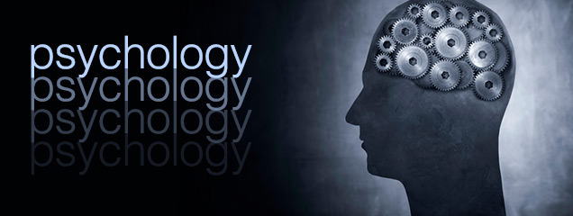
Psychology
Psychology as a Profession

Slide 2
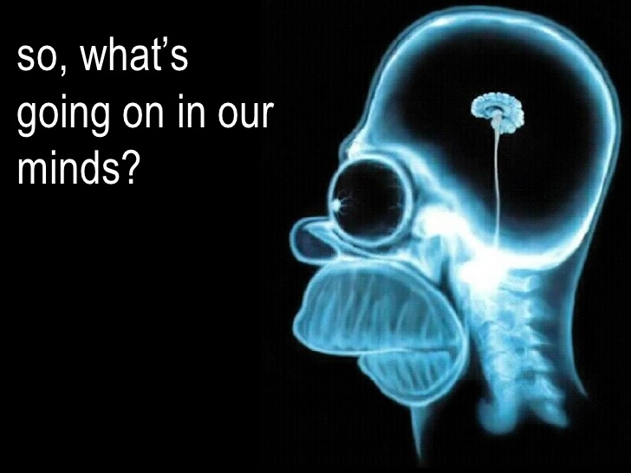
Introduction
Psychology as a Profession
Psychology relates to the study of human behavior at different levels (individual and group)
The study of psychology also helps to understand factors that affect mental health such as environmental and cultural factors.
There are also the different dynamics that have an effect on a particular group.
Basics of cognitive functions are discussed as well as the different postulations relating to specific behaviors

Slide 3
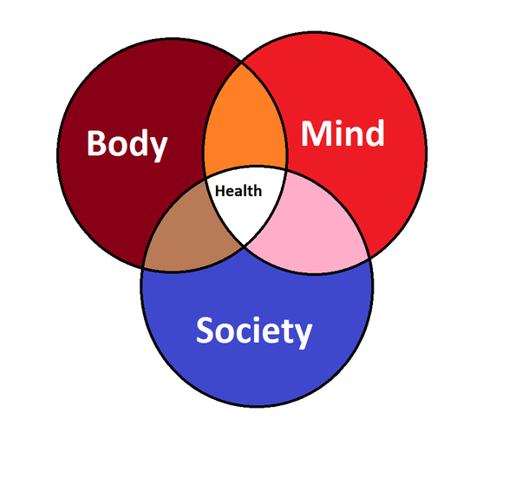
Psychology in a Biological Society
Biological Approach
Based on a biological approach, the belief is that we are as a consequence of our own genetics as well as physiology.
The approach examines feelings, thoughts, and behavior from a biological and physical point of view. These aspects thus have an ultimate biological cause.
The biological perspective helps in the study of psychology in different ways:

Slide 4
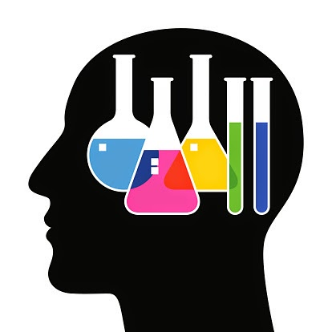
Psychology in a Biological Society
Biological Approach
Comparative studies: how different species of animals elate to each other and also understanding human behavior
Physiology: understand how hormones and the nervous system work, the functioning of the brain, and how structural or functional changes affect a person’s behavior.

Slide 5
Psychology in a Biological Society
Biological Approach
Investigation of inheritance: Genetics (mechanisms of inheritance), or what an animal inherits from its parents. For instance, whether high intelligence can be passed from one generation to the next.
Due to evolution, human genes have over millions of years adapted to the environment. Hence, most behavior will tend to have an evolutionary/adaptive purpose.

Slide 6
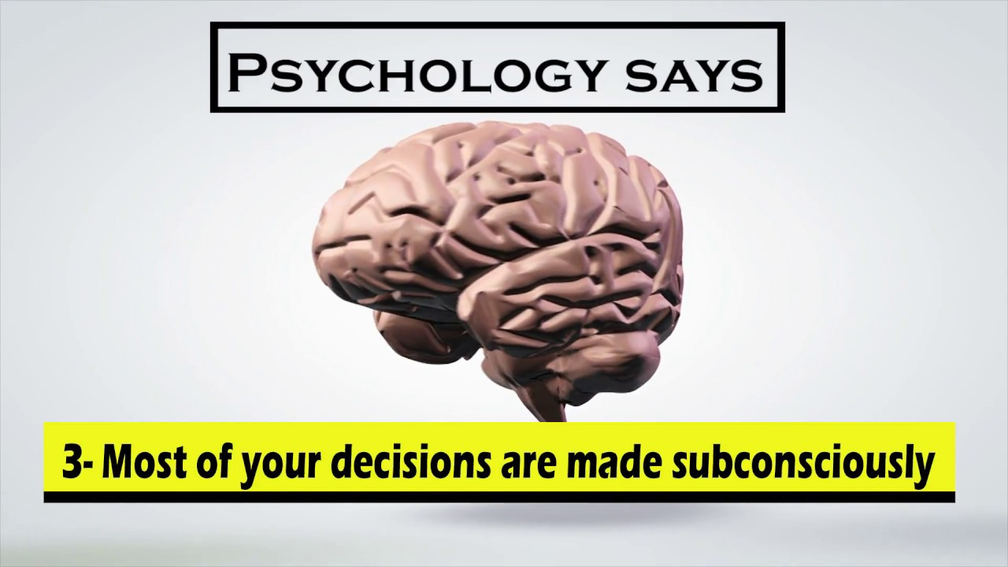
Human Behavior
Arguments have been whether human characteristic is environmentally or biologically determined. Others will pose questions such as is it learned or genetic?, nurtured or caused by nature?
Biology contributes highly to most of the psychological phenomena.
There is some behavioral impact where a child interacts with their loved ones or a caretaker.

Slide 7
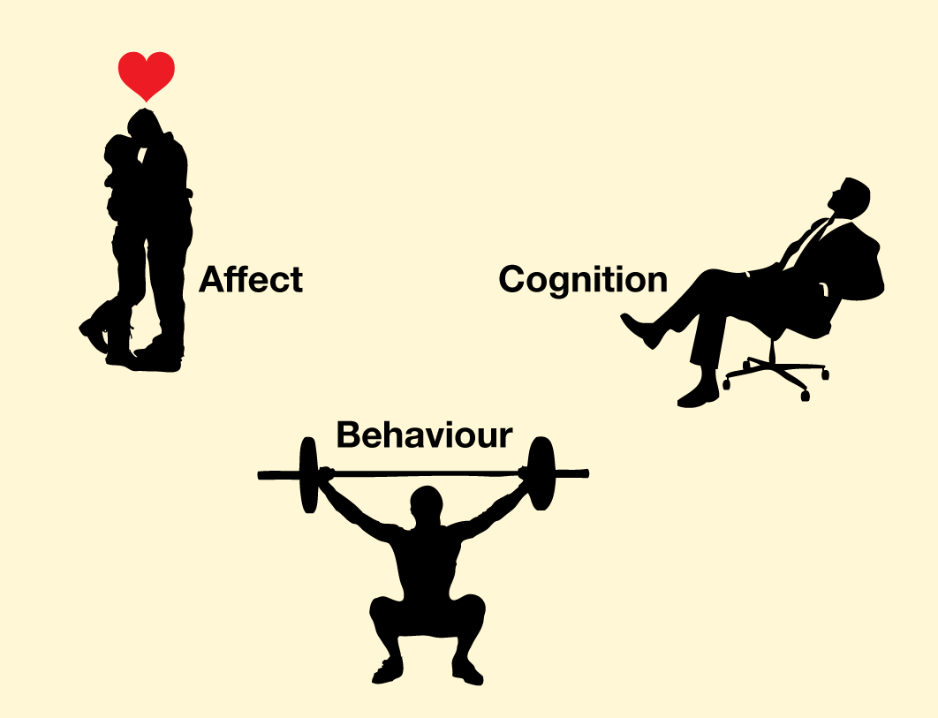
Human Behavior
Responsively, attachment related traits are developed such as trust, confidence, high levels of self esteem, emotional stability, resiliency, and impulse control.
Other traits are being compassionate and empathic and form friendships easily in their childhood years and form intimate relationships as adults.
On the other hand, children who are brought about by rejecting, cold, and inconsistent persons tend to have emotional and social problems.

Slide 8
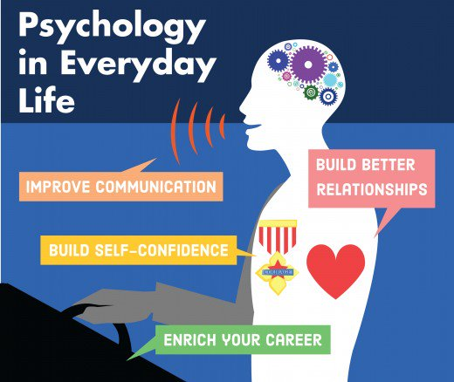
Impact on Lives
Psychology as a discipline impacts our daily living in the application of knowledge, improving education, relationships, and production in the work environment.
Psychology aims at understanding, prediction, and explanation of emotion, thoughts, and the behavior of human beings.
My passion in the field of psychology has been due to the study of human behavior.

Slide 9

Impact on Lives
In my daily life I have used psychology when reacting to situations and in performing various tasks in life.
The society operates through different processes that are as a result of psychology.
It is possible to study our own behavior by learning about our personality.

Slide 10
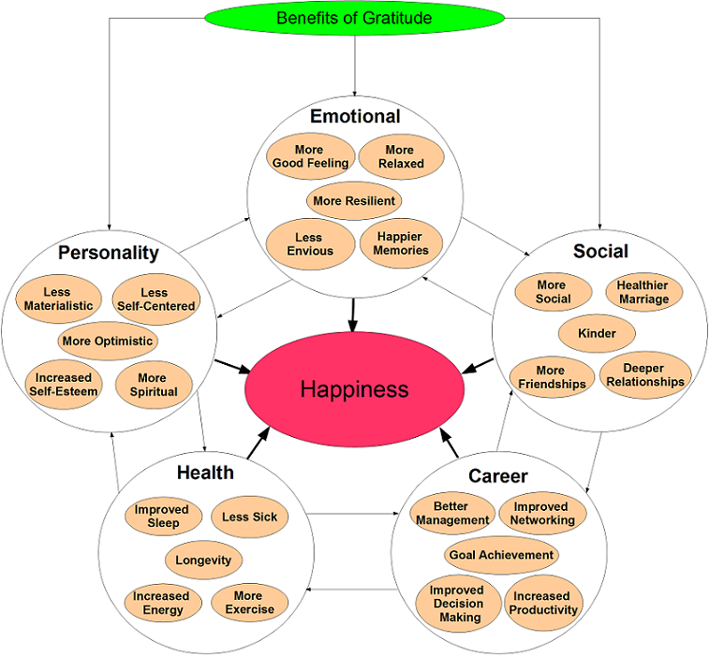
Psychology in Everyday Life
Psychology as a field is both interesting and challenging
Experts have the ability to study people’s behavior by observation, principles, and scientific methods.
There is application of knowledge and skills in various areas such as sports, health, law, and education.
Through developmental and counseling psychology, psychologists are able to understand other people as well as the functioning of the society.

Slide 11
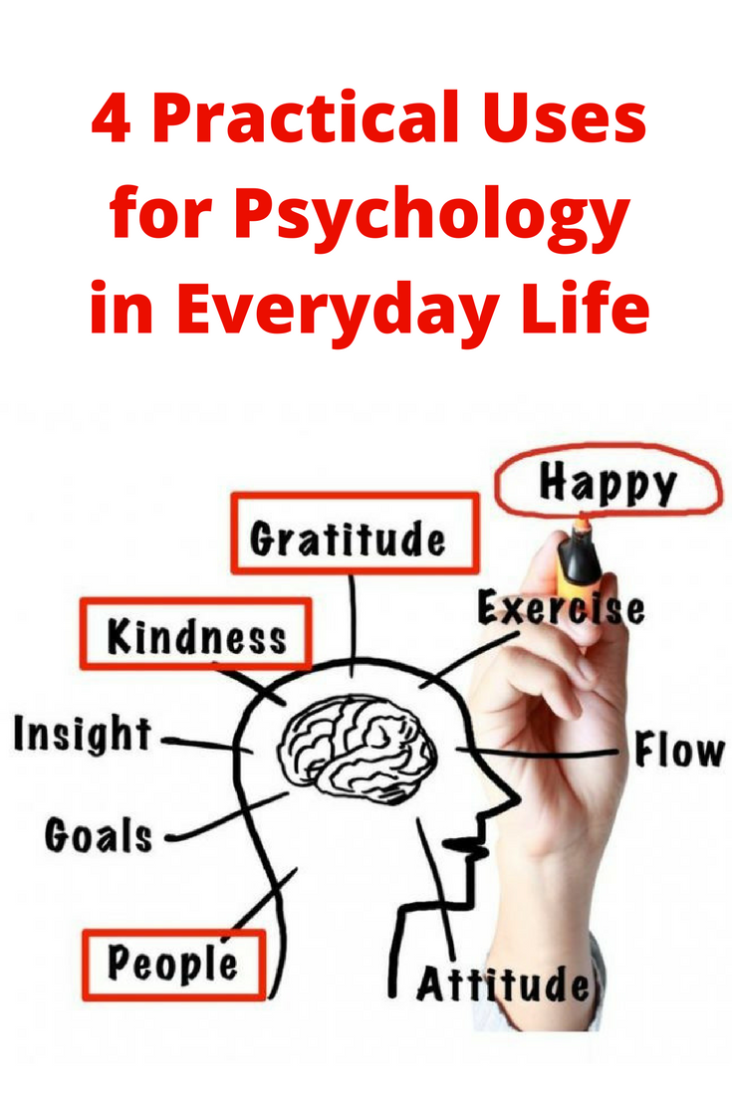
Psychology In Everyday Life
Psychology works towards ensuring people are happy and mentally sound.
The psychologists relate the theoretical perspectives with the practical experiences in the society.
Psychology in relationship building
Making it easier to live with others , enhancing understanding in order to understand them more and accommodating their behavior. It enhances romantic compatibility

Slide 12
Psychology in Everyday Life
Improving Communication
Improving Communication
Psychology helps us to communicate better with others since we are able understand other people and relate to how they think and behave. Communication is more effective when we are able to understand the meaning of actions and gestures.

Slide 13
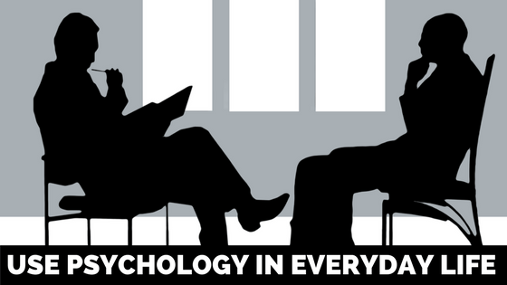
Psychology in Everyday Life
Building self-confidence
Where a person understands himself and his personality, they can gain more self-confidence. One can learn their weaknesses and work on them or build on them
Enriching careers
Psychology is essential for coworkers as it helps them understand each other and build friendships. and thus enrich their careers.

Slide 14
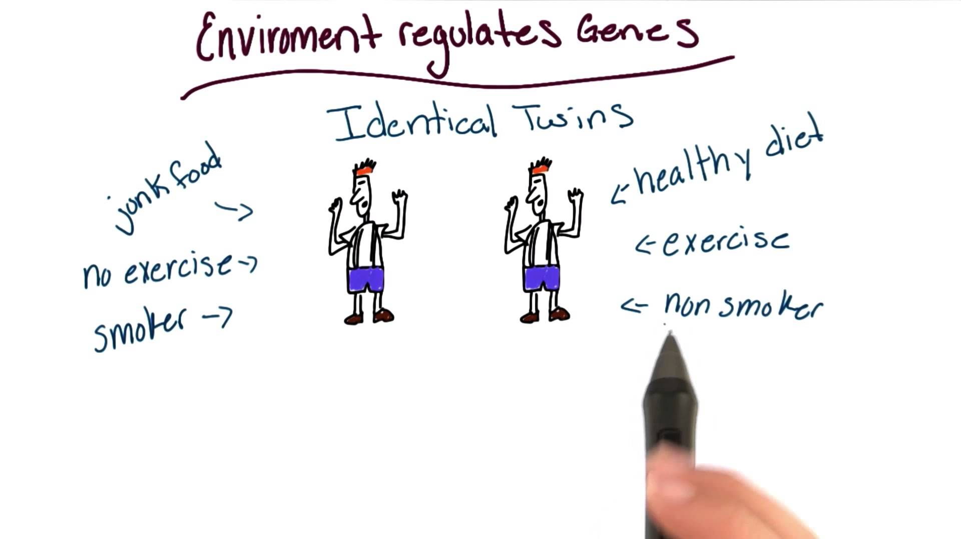
Genes In Psychology
Psychology has explored genetic studies in order to understand human behavior.
DAT 1 gene is one of the genes that has gained a lot of interest in psychology since it is believed to regulate the expression of dopamine in human beings. The phenotype of DAT 1 gene is hyperactive behavior in human beings.
Dopamine is a neurotransmitter that has been implicated in various mood disorders.
Rats are the commonly used animal models in carrying out gene knock-out studies.

Slide 15

Thank You
Name

